Slide 1

Department of Computer Science and Engineering
(cyber security)
CS23531-Web Programming
SHARESHELF: A SECURE RESOURCE SHARING SYSTEM WITH PERMISSION-BASED ACCESS.
College Name: Rajalakshmi Engineering college
Presented By: DHANALAKSHMI C - 241901023

Slide 2
List of Content
Abstract
Introduction
Literature Survey
Problem Statement
Proposed work
System Architecture
Methodology
Output
Conclusion
References

Slide 3
Abstract
ShareShelf is a web-based system for sharing study resources such as notes, books, links and documents.
Users upload resources, browse resources shared by others, and request access to protected ones.
Owners choose Public, Private with requests allowed, or Private only, and approve or reject requests.
Permissions are enforced on the backend, so protected files cannot be opened without approval.
Built with React (Vite), Node.js/Express and MySQL/MariaDB.

Slide 4
Introduction
Students and teams often share files through chats and drives, where owners lose control over who can open them.
Sharing needs a structured way to publish resources while protecting private material.
ShareShelf gives each user a personal shelf and a common Explore section.
Access to protected resources is controlled by the owner.

Slide 5
Literature Survey
Ref. | Existing Work | What it does | Limitation
[1] | Sandhu et al., Role-Based Access Control Models (1996) | Permissions assigned by user role | Roles are fixed, so they don’t fit per-resource decisions made by each owner
[2] | Hu et al., Guide to ABAC, NIST SP 800-162 (2014) | Access decisions based on attributes of the user and the resource | Flexible but complex, and heavy for a small sharing application
[3] | Jones et al., JSON Web Token (JWT), RFC 7519 (2015) | Stateless, verifiable login tokens | Proves identity only, so permissions must still be checked on the server for every request

Slide 6
Problem Statement
Shared study resources are scattered across platforms.
Link sharing exposes files to anyone who gets the link.
Owners cannot easily see or control who accesses their files.
There is a need for a simple system where owners decide who can open each resource, with the decision enforced by the server.

Slide 7
Proposed Work
Upload resources with title, description, category, optional link and optional document.
An Explore Resources section with search.
Three access settings: Public, Private with requests allowed, Private only.
A Request Access workflow with Pending, Approved and Rejected statuses.
Owners approve, reject or revoke requests.
Secure file handling: type and size validation, and private storage.

Slide 8
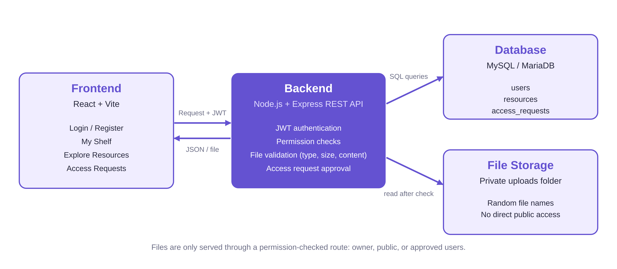
System Architecture

Slide 9
Methodology
Users register and log in; the server issues a JWT.
A resource is saved with its access setting, and any uploaded file is checked for type, size and real file content.
Explore lists other users’ public and request-only resources; private ones are never returned.
A user sends a request, which is saved as Pending.
The owner approves or rejects it.
On every file open, the backend checks whether the user is the owner, the resource is public, or the request is approved.

Slide 10
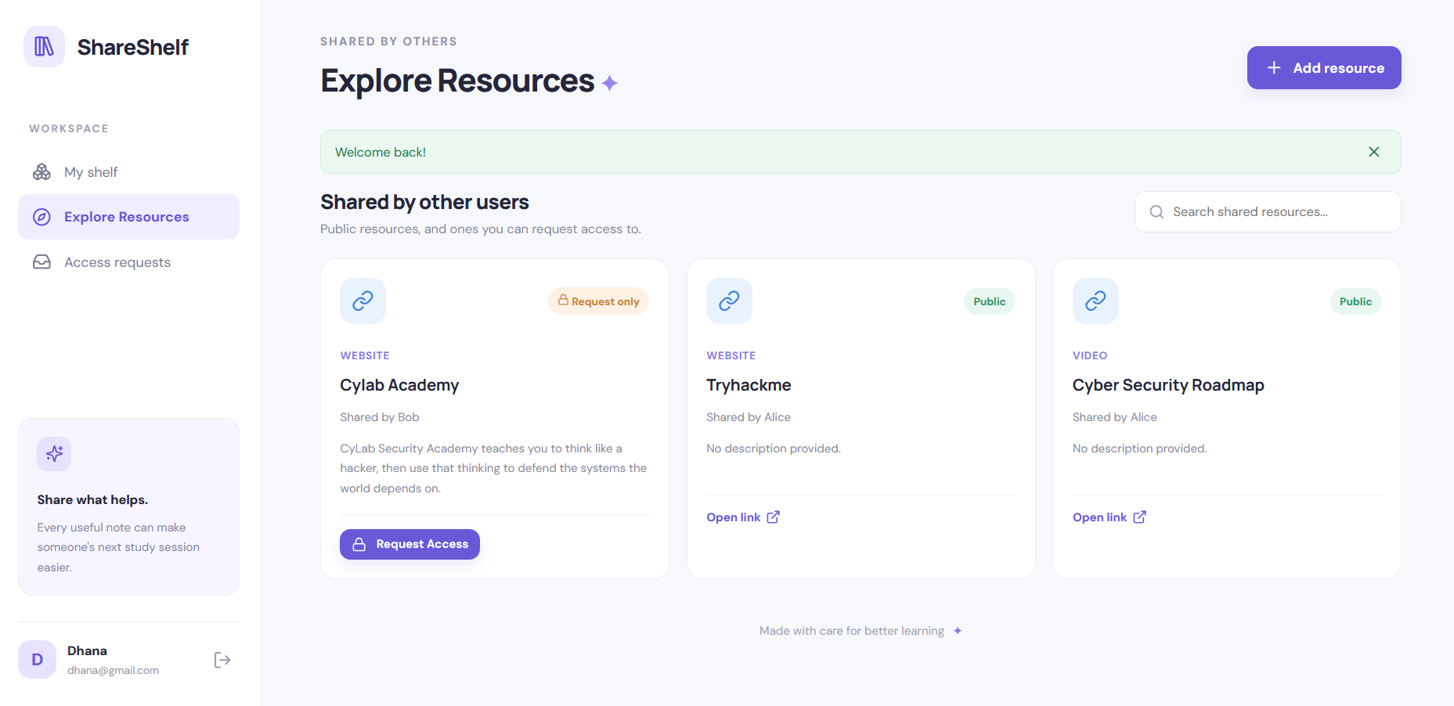
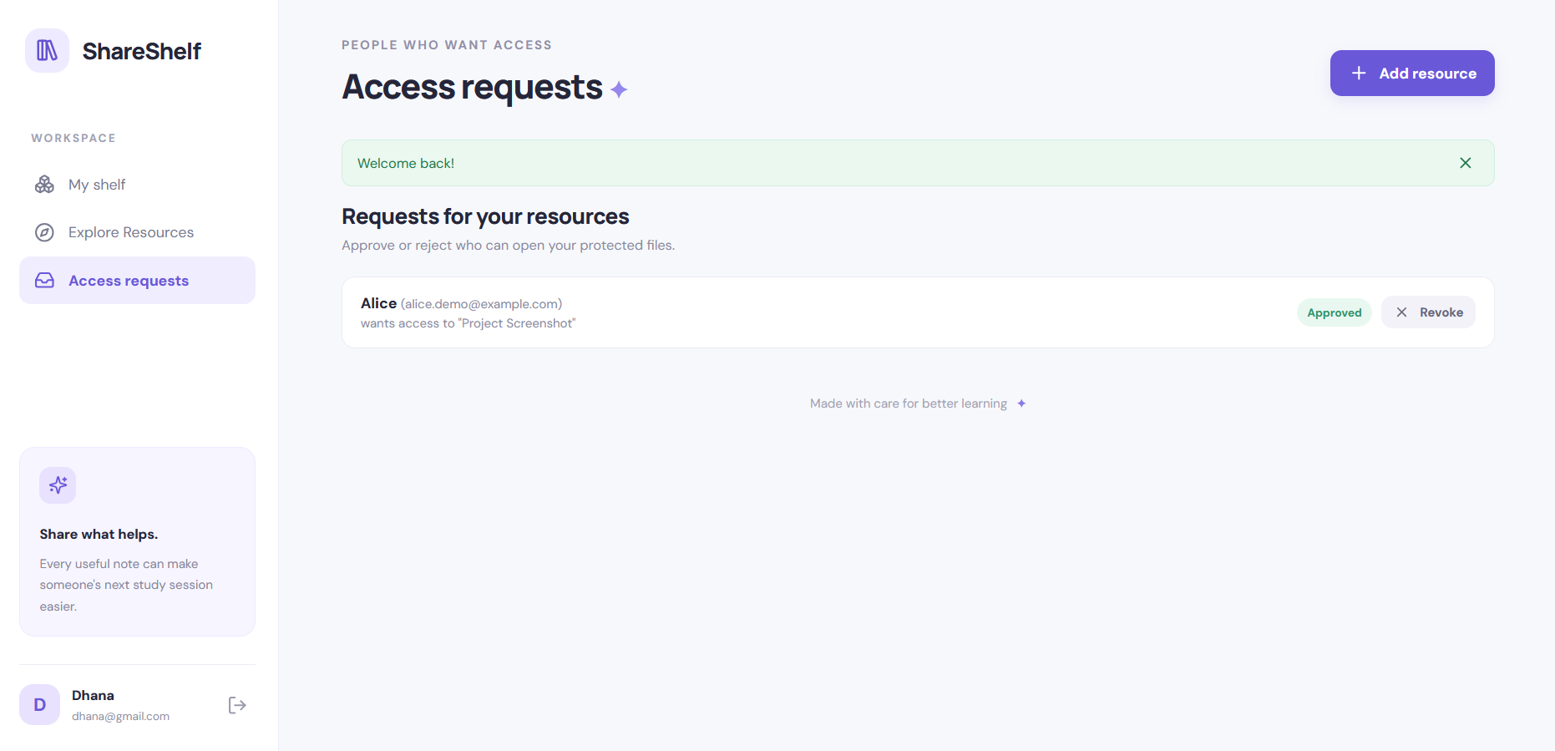
Results and Discussions

Slide 11
Conclusion
ShareShelf lets users share resources while keeping control of who can access them.
Backend permission checks protect files even if someone bypasses the interface.
The Request Access workflow gives owners a simple way to approve, reject or revoke access, and gives requesters a clear status.
Future work: email notifications, resource editing, file previews and automated tests.

Slide 12
References
[1] R. Sandhu, E. Coyne, H. Feinstein, C. Youman, “Role-Based Access Control Models,” IEEE Computer, vol. 29, no. 2, pp. 38–47, 1996.
[2] V. Hu et al., “Guide to Attribute Based Access Control (ABAC) Definition and Considerations,” NIST SP 800-162, 2014.
[3] M. Jones, J. Bradley, N. Sakimura, “JSON Web Token (JWT),” RFC 7519, IETF, 2015.

